Slide 1
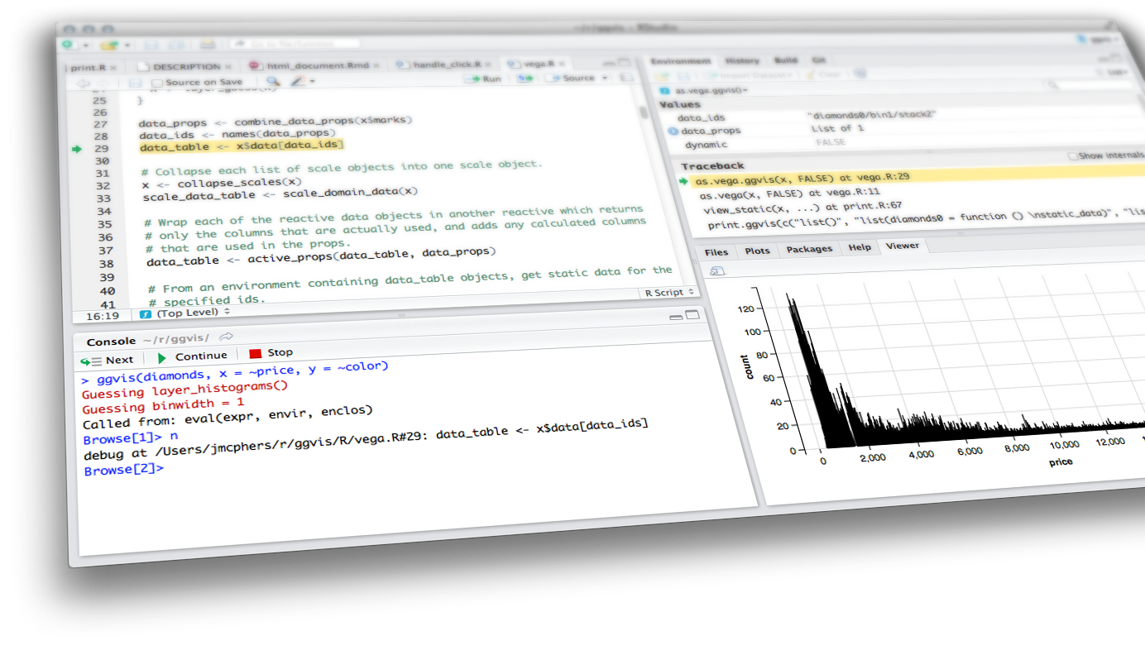

reactive programming & Dashboards
Shiny from

Slide 2
Reactive Programming Part 2
Stop - trigger - delay
isolate()
observeEvent()
eventReactive()
Scheduling
Schedule with invalidateLater()
Monitor with reactivePoll()
reactiveFileReader()
Reactivity best practices
Dashboards
What is in a dashboard?
Server
reactiveFileReader
reactivePoll
UI
Static vs. dynamic dashboards
Shiny pre-rendered
shinydashboard

Slide 3
Stop - trigger -
delay

Slide 4
Stop with isolate()

Slide 5
Isolate
Use isolate() to wrap an expression whose reactivity should be suppressed (i.e. the currently executing reactive expression/observer/output shouldn't be notified when something changes).
Notes:
Mine, I found the comparison between reactive expression and isolate misleading because reactive() creates a function-like thing and isolate() immediately returns the value of the expression you pass it. So isolate() is like "run this code now but with a modifier" while reactive() is like "create a new reactive object using this code and I'm going to use it from elsewhere" which is a much larger responsibility.

Slide 6
demo
Only update plot title when other components of the plot are also updated. See movies_14.R.
Plot title will update
when any of the other inputs in this chunk change
server:
pretty_plot_title <- reactive({ toTitleCase(input$plot_title) })
output$scatterplot <- renderPlot({
ggplot(data = movies_subset(), aes_string(x = input$x, y = input$y, color = input$z)) +
geom_point(alpha = input$alpha, size = input$size) +
labs(title = isolate({ pretty_plot_title() }) )
})
Plot title will not update
when input$plot_title changes
Shiny from
© 2016 RStudio, Inc. All rights reserved.

Slide 7
Trigger with observeEvent()

Slide 8
triggering A Reaction
observeEvent() can be used to trigger a reaction
It uses a different syntax
observeEvent(eventExpr, handlerExpr, …)
simple reactive value - input$click,
call to reactive expression - df(),
or complex expression inside {}
expression to call whenever eventExpr is invalidated

Slide 9
demo
Write a CSV of the sampled data when action button is pressed. See movies_15.R.
ui:
actionButton(inputId = "write_csv", label = "Write CSV")
server:
observeEvent(eventExpr = input$write_csv,
handlerExpr = {
filename <- paste0("movies_", str_replace_all(Sys.time(), ":|\ ", "_"), ".csv")
write.csv(movies_sample(), file = filename, row.names = FALSE)
}
)
Shiny from
© 2016 RStudio, Inc. All rights reserved.
Notes:
use Sys.time in name to distinguish between files downloaded

Slide 10
isolate vs. observeevent
isolate() is used to stop a reaction
while observeEvent() is used to perform an action in response to an event
Note: "recalculate a value" does not generally count as performing an action, we’ll next discuss eventReactive() for that

Slide 11
Delay reactions with
eventReactive()

Slide 12
observeevent vs. eventreactive
observeEvent() is to to perform an action in response to an event
while eventReactive() is used to create a calculated value that only updates in response to an event
Just like a normal reactive expression except only invalidates in response to the given event.
observeEvent(eventExpr, valueExpr, …)

Slide 13

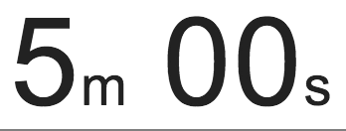
exercise
Change how the random sample is generated such that it is updated when the user clicks on an action button that says “Get new sample”.
Use movies_15.R as the basis of the script and make the updates there.
Run the app to ensure that the behavior is as described
Compare your code / output with the person sitting next to / nearby you
Shiny from
© 2016 RStudio, Inc. All rights reserved.

Slide 14
Solution
Solution can also be found in movies_16.R.
ui:
actionButton(inputId = "get_new_sample",
label = "Get new sample")
server:
movies_sample <- eventReactive(eventExpr = input$get_new_sample,
valueExpr = {
req(input$n_samp)
sample_n(movies_subset(), input$n_samp)
},
ignoreNULL = FALSE
)
Initially perform the action/calculation and just let the user re-initiate it (like a "Recalculate" button)
Shiny from
© 2016 RStudio, Inc. All rights reserved.
Notes:
create a calculated value that only updates in response to an event as opposed to perform an action in response to an event

Slide 15
Scheduling

Slide 16
Schedule with invalidateLater()

Slide 17
invalidatelater
If this is placed within an observer or reactive expression, that object will be invalidated (and re-execute) after the interval has passed
The re-execution will reset the invalidation flag, so in a typical use case, the object will keep re-executing and waiting for the specified interval.
It's possible to stop this cycle by adding conditional logic that prevents the invalidateLater() from being run.

Slide 18
demo
Tell the user how long they have been viewing your app for. See movies_17.R.
ui:
textOutput(outputId = "time_elapsed")
server:
# Calculate time difference between when app is first launched and now
beg <- reactive({ Sys.time() })
now <- reactive({ invalidateLater(millis = 1000); Sys.time() })
diff <- reactive({ round(difftime(now(), beg(), units = "secs")) })
# Print time viewing app
output$time_elapsed <- renderText({
paste("You have been viewing this app for", diff(), "seconds.")
})
Shiny from
© 2016 RStudio, Inc. All rights reserved.
Notes:
use Sys.time in name to distinguish between files downloaded

Slide 19
exercise
Change how the random sample is generated such that it is updated every 5 seconds
Don’t forget to remove now unused functionality for the action button to get a new sample
Use movies_17.R as the basis of the script and make the updates there
Run the app to ensure that the behavior is as described
Compare your code / output with the person sitting next to / nearby you
Shiny from
© 2016 RStudio, Inc. All rights reserved.

Slide 20
Solution
Solution can also be found in movies_18.R.
ui:
actionButton(inputId = "get_new_sample", label = "Get new sample")
server:
# Get new sample every 5 seconds
movies_sample <- reactive({ invalidateLater(millis = 5000)
req(input$n_samp)
sample_n(movies_subset(), input$n_samp)
})
Shiny from
© 2016 RStudio, Inc. All rights reserved.
Notes:
This is a bit distracting so we won’t be building on it going forward.

Slide 21
Monitor with reactivePoll()

Slide 22
reactivepoll
reactivePoll() pairs a relatively cheap "check" function with a more expensive value retrieval function
Check function: is executed periodically and should always return a consistent value until the data changes
Note doesn’t return TRUE or FALSE, instead it indicates change by returning a different value from the previous time it was called
Value retrieval function: is used to re-populate the data when the check function returns a different value
Similar to invalidateLater(), but it’s based on a change in a file as opposed to a periodic change

Slide 23
demo
Periodically check and report the names and dimensions of CSV files in the directory.
Write the check and value retrieval functions for reactivePoll()
Count and list CSV files in the directory every 5 seconds with reactivePoll()
Store CSV files in the directory as a data table in output$csv_files
Print output$csv_files in the UI, use tabs to reduce clutter
Shiny from
© 2016 RStudio, Inc. All rights reserved.

Slide 24
demo
Write the check and value retrieval functions for reactivePoll()
# Check function
count_files <- function(){ length(dir(pattern = "*.csv")) }
# Value retrieval function
list_files <- function(){
files <- dir(pattern = "*.csv")
if(length(files) == 0){ return( data.frame() ) }
sapply(files, function(file) dim(read.csv(file))) %>%
unlist() %>%
t() %>%
as.data.frame() %>%
setNames(c("rows", "cols"))
}
There are many ways of doing this, don’t focus too much on this code
Shiny from
© 2016 RStudio, Inc. All rights reserved.

Slide 25
demo
Count and list CSV files in the directory every 5 seconds with reactivePoll()
# Count and list CSV files in the directory every 5 seconds
csv_files <- reactivePoll(intervalMillis = 5000,
session,
checkFunc = count_files,
valueFunc = list_files)
Shiny from
© 2016 RStudio, Inc. All rights reserved.

Slide 26
demo
Store CSV files in the directory as a data table in output$csv_files
# Print CSV files in the directory
output$csv_files <- DT::renderDataTable(
DT::datatable(data = csv_files(),
options = list(pageLength = 10),
rownames = TRUE)
Shiny from
© 2016 RStudio, Inc. All rights reserved.

Slide 27
demo
Print output$csv_files in the UI, use tabs to reduce clutter
# Use tabs for the data tables to reduce clutter
tabsetPanel(
# Show data table
tabPanel("Plotted data", dataTableOutput(outputId = "moviestable")),
# Show CSV files in directory
tabPanel("Files in directory", dataTableOutput(outputId = "csv_files"))
)
This is new syntax we haven’t seen before
Shiny from
© 2016 RStudio, Inc. All rights reserved.

Slide 28
demo
Putting it all together…
movies_19.R
See it in action: Change sample size, get new sample,
write data to CSV, check out the “Files in directory” tab.
Then, delete all CSV files in directory, and see the list update.
Shiny from
© 2016 RStudio, Inc. All rights reserved.
Notes:
Putting it all together…

Slide 29
reactiveFileReader()

Slide 30
reactivefilereader
reactiveFileReader() works by periodically checking the file's last modified time
If the file has changed, it is re-read and any reactive dependents are invalidated
Also similar to invalidateLater() but instead of periodic updates, updates are based on changes in a file

Slide 31
Reactivity
best practices

Slide 32
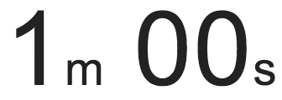
exercise
Is there something wrong with this? If so, what?
ui <- fluidPage(
titlePanel("Add 2"),
sidebarLayout(
sidebarPanel( sliderInput("x", "Select x", min = 1, max = 50, value = 30) ),
mainPanel( textOutput("x_updated") )
)
)
server <- function(input, output) {
add_2 <- function(x) { x + 2 }
current_x <- add_2(input$x)
output$x_updated <- renderText({ current_x })
}
Shiny from
© 2016 RStudio, Inc. All rights reserved.

Slide 33
Solution
Yup! See add_2.R.
ui <- fluidPage(
titlePanel("Add 2"),
sidebarLayout(
sidebarPanel( sliderInput("x", "Select x", min = 1, max = 50, value = 30) ),
mainPanel( textOutput("x_updated") )
)
)
server <- function(input, output) {
add_2 <- function(x) { x + 2 }
current_x <- reactive({ add_2(input$x) })
output$x_updated <- renderText({ current_x() })
}
Shiny from
© 2016 RStudio, Inc. All rights reserved.

Slide 34
lesson 1
Reactives are equivalent to no argument functions
Think about them as functions, think about them as variables that can depend on user input and other reactives

Slide 35
exercise
observe() vs. reactive()
Which one should you use if you want to create an object that you can later use in a render function?
Which one if you want to update the minimum value of a slider input based on the choices a user makes in the app?
Shiny from
© 2016 RStudio, Inc. All rights reserved.

Slide 36
Solution
observe() vs. reactive()
Which one should you use if you want to create an object that you can later use in a render function?
reactive()
Which one if you want to update the minimum value of a slider input based on the choices a user makes in the app?
observe()
Shiny from
© 2016 RStudio, Inc. All rights reserved.

Slide 37
lesson 2
Reactives are for reactive values and expressions
Observers are for their side effects

Slide 38
exercise
Is there something wrong with this? If so, what?
ui <- fluidPage(
sidebarLayout(
sidebarPanel(sliderInput("n", "Select n", min = 1,
max = 50, value = 30)),
mainPanel(
plotOutput("hist"),
textOutput("med")
)
)
)
server <- function(input, output) {
dist <- reactive({ rnorm(input$n) })
output$hist <- renderPlot({
hist(dist())
med <- reactive({ median(dist()) })
abline(v = med(), col = "red")
})
output$med <- renderText({
paste("The median is", round(med(), 3))
})
}
Shiny from
© 2016 RStudio, Inc. All rights reserved.

Slide 39
Solution
Oh yeah! See hist_med.R.
ui <- fluidPage(
sidebarLayout(
sidebarPanel(sliderInput("n", "Select n", min = 1,
max = 50, value = 30)),
mainPanel(
plotOutput("hist"),
textOutput("medtext")
)
)
)
server <- function(input, output) {
dist <- reactive({ rnorm(input$n) })
med <- reactive({ median(dist()) })
output$hist <- renderPlot({
hist(dist())
abline(v = med(), col = "red")
})
output$medtext <- renderText({
paste("The median is", round(med(), 3))
})
}
Shiny from
© 2016 RStudio, Inc. All rights reserved.

Slide 40
dashboards
Shiny from

Slide 41
What is in a
dashboard?

Slide 42
dashboards
Automatically updating
Not just based on user gestures
But also when data source changes
Many viewers looking at the same data
May or may not be interactive

Slide 43
Server

Slide 44
motivation
You have new data coming in — constantly, continuously, or on a schedule
When new data comes in, it’s automatically received, and transformed, aggregated, summarized, etc.
May want to call attention to exceptional results

Slide 45
exercise
Why might this not be a good idea?
dataset <- reactive({
result <- read.csv(“data.csv")
invalidateLater(5000)
result
})
output$plot <- renderPlot({
plot(dataset()) # or whatever
})
Shiny from

Slide 46
Solution
Lots of overhead!
Shiny from

Slide 47
reactiveFileReader

Slide 48
reactivefilereader
Reads the given file ("data.csv") using the given function (read.csv)
Periodically reads the last-modified time of the file
If the timestamp changes, then (and only then) re-reads the file
dataset <- reactiveFileReader(
intervalMillis = 1000,
session = session,
filePath = "data.csv",
readFunc = read.csv
)
output$plot <- renderPlot({
plot(dataset()) # or whatever
})
Single file, on disk
(not database or web API)
Must have data path as first argument

Slide 49
reactivefilereader
dataset <- reactiveFileReader(
intervalMillis = 1000,
session = session,
filePath = "data.csv",
readFunc = read.csv,
stringsAsFactors = FALSE
)
output$plot <- renderPlot({
plot(dataset()) # or whatever
})
Add any named arguments

Slide 50
reactivePoll

Slide 51
reactivepoll
reactiveFileReader is limited to files on disk. It doesn't work for non-file-based data sources like databases or web APIs
reactivePoll is a generalization of reactiveFileReader
checkFunc: A function that can execute quickly, and merely determine if anything has changed
Should be fast as it will block the R process while it runs! The slower it is, the greater you should make the polling interval.
Should not return TRUE or FALSE for changed/unchanged. Instead, just return a value (like the timestamp, or the count); it's reactivePoll's job, not yours, to keep track of whether that value is the same as the previous value or not.
valueFunc: A function with the (potentially expensive) logic for actually reading the data

Slide 52
exercise
When might we want to use reactivePoll on dashboards?
Shiny from

Slide 53
Solution
When we are pulling from a database or Web API!
QueriedData <- reactivePoll(30000, session,
# This function checks the rows and when the rows are higher than previously, in those cases it reads the table
checkFunc = function(){
# connect
con <- poolCheckout(mysqldb)
# Return the current numbers of rows in mysqltable
rowcount <- dbGetQuery(con, "SHOW TABLE STATUS;") %>% filter(Name == "mysqltable") %>% pull(Rows)
# disconnect database
poolReturn(con
},
valueFunc = function() {
# connect
con <- poolCheckout(mysqldb)
test_db <- dbReadTable(con, “mysqltable”)
})
output$mytable <- DT::renderDT({
test_db <- QueriedData() %>% as.data.frame()
DT::datatable(test_db)
})
Shiny from

Slide 54
Static vs. dynamic
dashboards

Slide 55
static vs. dynamic
Static:
R code runs once and generates an HTML page
Generation of this HTML can be scheduled
Dynamic:
Client web browser connects to an R session running on server
User input causes server to do things and send information back to client
Interactivity can be on client and server
Can update data in real time
User potentially can do anything that R can do

Slide 56
FLEX vs. SHINY Dashboard
flexdashboard | shinydashboard
R Markdown | Shiny UI code
Super easy | Not quite as easy
Static or dynamic | Dynamic
CSS flexbox layout | Bootstrap grid layout

Slide 57
flexdashboard

Slide 58
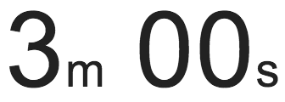
exercise
library(flexdashboard)
File → New file → R Markdown → From Template
Create three plots that go in each of the panes using built-in R datasets or any data we have used in the worksho (or your own data)
Shiny from

Slide 59
exercise
Open apps/flexdashboard_01.Rmd
How is it different than Shiny apps we have been building so far, how is it similar?
Make a change to the layout of the dashboard, see http://rmarkdown.rstudio.com/flexdashboard/using.html#layout for help
Change the theme of the dashboard, see http://rmarkdown.rstudio.com/flexdashboard/using.html#appearance for help
Shiny from

Slide 60
shiny documents
Add runtime: shiny to header.
Add inputs in code chunks.
Add renderXyz functions in code chunks.
No need for output$x <- assignment, or for xyzOutput functions.

Slide 61
exercise
Continue working on apps/dashboards/flexdashboard_01.Rmd
Add another UI widget, a radioButton, that allows the user to select whether the plot used to visualize the distribution of weight should be histogram or a violin plot
Shiny from

Slide 62
Solution
Sample solution at apps/flexdashboard_02.Rmd
Shiny from

Slide 63
shiny document drawbacks
Start-up time: knits document every time someone visits it
Resizing can trigger re-knit
Auto-reconnection doesn’t work (i.e. client browsers cannot automatically reconnect afer being disconnected due to network problems)
The solution: Pre-rendered Shiny Documents

Slide 64
Shiny
pre-rendered

Slide 65
shiny pre_rendered
Rendering phase: UI code (and select other code) is run once, before users connect.
Serving phase: Server code is run once for each user session.
Each phase is run in a separate R sessions and can’t access variables from the other phase.

Slide 66
Contexts for shiny_prerendered
"render": Runs in rendering phase (like ui)
"server": Runs in serving phase (like server)
Additional contexts:
"setup": Runs in both phases (like global.R)
"data": Runs in rendering phase (any variables are saved to a file, and available to serving phase, useful for data preprocessing)
"server-start": Runs once in serving phase, when the Shiny document is first run and is not re-executed for each new user of the document, appropriate for
establishing shared connections to remote servers (e.g. databases, Spark contexts, etc.)
creating reactive values to be shared across sessions (e.g. with reactivePoll, reactiveFileReader)

Slide 67
exercise
Start with apps/flexdashboard_02.Rmd
Turn your document into runtime: shiny_prerendered
Note: You will need to use output$x <- assignment and xyzOutput functions
Shiny from

Slide 68
Solution
Sample solution at apps/flexdashboard_03.Rmd
Shiny from

Slide 69
shinydashboard

Slide 70
FOrmat
shinydashboard is an advanced layout of a typical shiny app
The ui has more arguments
header
sidebarMenu
body (similar to fluid pages)
title
skin (color of the page)

Slide 71
Body

Slide 72
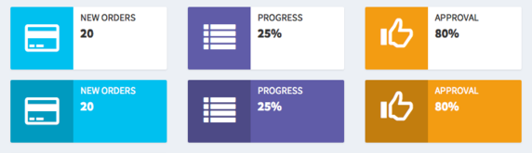
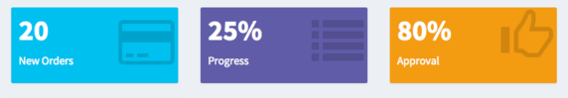

Slide 73
exercise
Open starwars_01.R
Add an info or value box counting for mass and height respectively (lines 120 or 125)
Hint: First run the app to figure out what measurements might make sense
Stretch goal: Create the other kind of box
Shiny from

Slide 74
Solution
See starwars_02.R
Shiny from

Slide 75
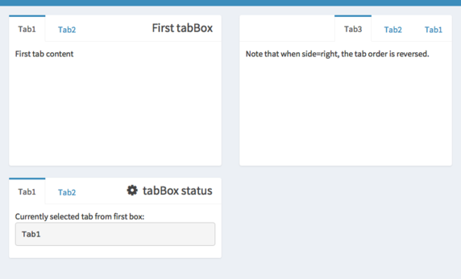
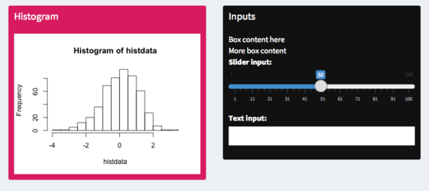

Slide 76
exercise
Open starwars_02.R
Add a tabBox in the body that holds the output of both the plots for mass and height.
What arguments do you need to pass to the box so the table fits?
Stretch goal: Give the box a title
Shiny from

Slide 77
Solution
See starwars_03.R
Shiny from

Slide 78
Menu

Slide 79
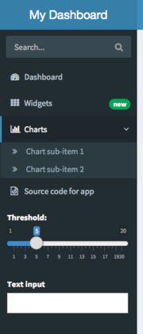
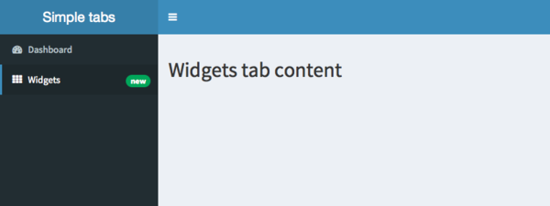

Slide 80
exercise
Open starwars_03.R
Add a new menu item that allows users to access the table page
Shiny from

Slide 81
Solution
See starwars_04.R
Shiny from

Slide 82
Header

Slide 83
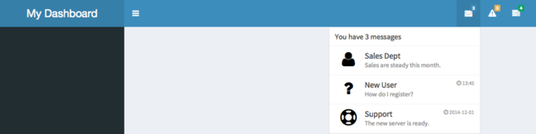

Slide 84
Header
Headers have three types of information that can be displayed
messageItem - text information along with date/time information
notificationItem - basic text information
taskItem - show progress towards a goal
All of these items can be dynamically updated and rendered in the server function
For examples see the shinydashboard docs

Slide 85
demo
starwars_04.R
Shiny from
© 2016 RStudio, Inc. All rights reserved.

Slide 86
Dashboards
Shiny from

Slide 87

Homework
Project 1

Slide 88
Homework
Creating multiple types of visuals from the same data is an important way to convey information to application users. Students will create a Dashboard using a static download of an Open Data or a Dataset from their own place of employment (make sure you have permission to use it for this assignment first!)
Students may make their application in either flexdashboard or shinydashboard layouts and deploy on shinyapps.io.
Directions:
Include at least:
Three (3) input/filters
Three (3) single numeric based boxes/gauges
One (1) datatable
Three (3) interactive and reactively responsive charts. (use ggplot2 for now)
These elements should be places throughout a dashboard with at least three (3) pages or tabs with an analytical themes or question about the data.
On the server side your plots and tables must utilize the reactive function for any and all datasets.
Your final app must work when deployed to shinyapps.io.
Project 1
Due Date: 9/27

